Slide 1
Bias and Variance

Slide 2
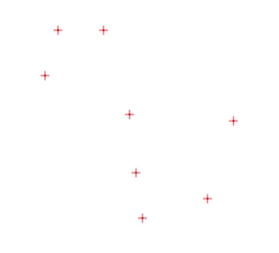
Given set of points

Slide 3
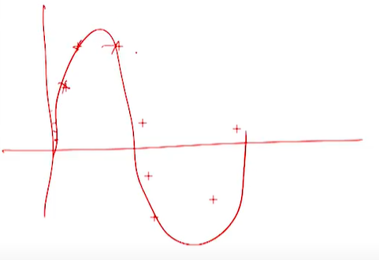
This is actual function for this data ( which we never know for real world problem)

Slide 4

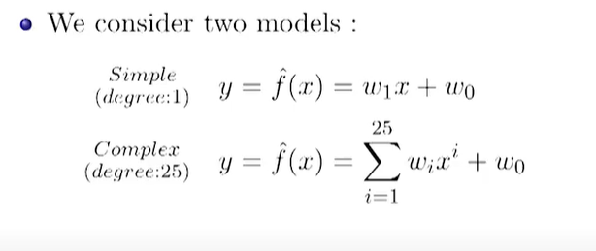

Slide 5
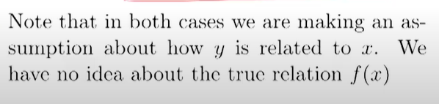

Slide 6
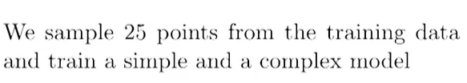
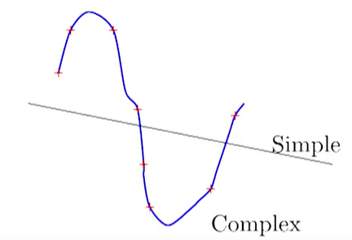

Slide 7
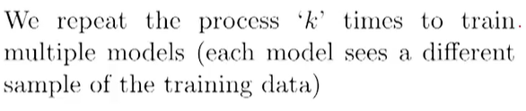

Slide 8
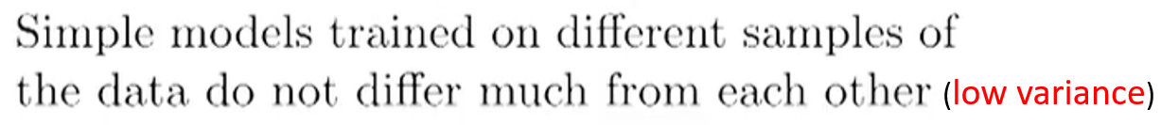
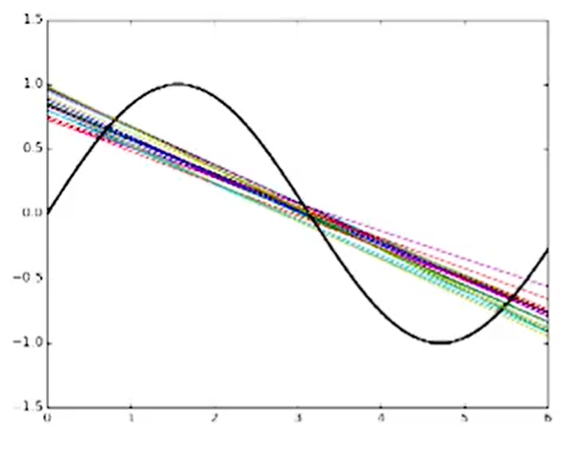
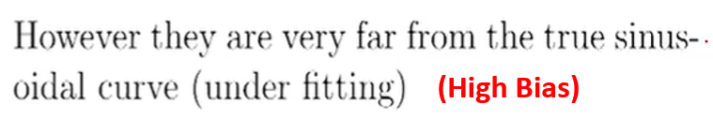

Slide 9
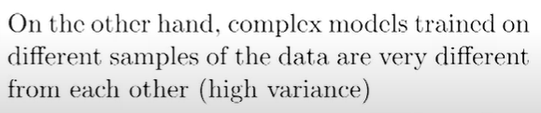
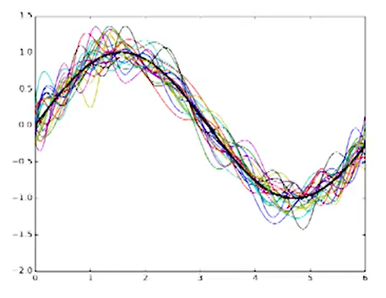
However they are very near to true
sinusoidal curve (low Bias)

Slide 10

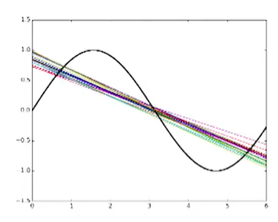
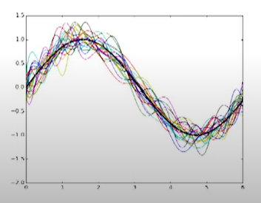


Slide 11
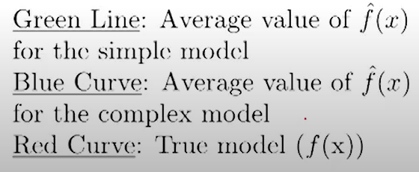
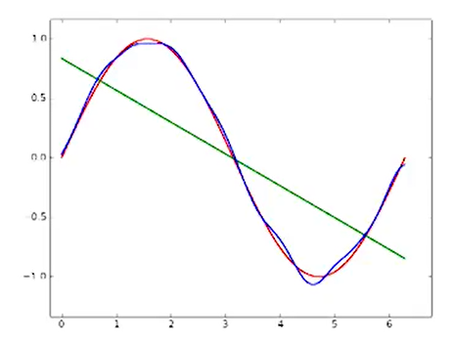

Slide 12
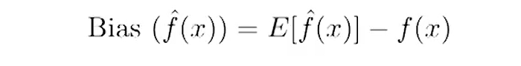
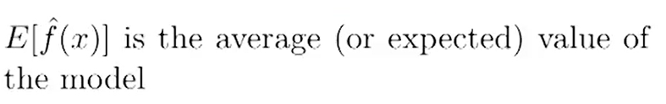
Bias

Slide 13
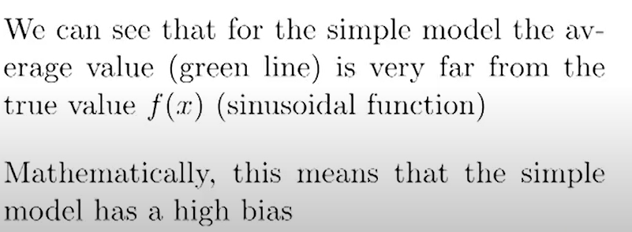

Slide 14
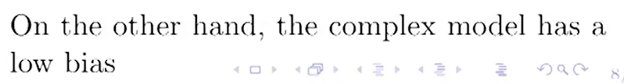

Slide 15
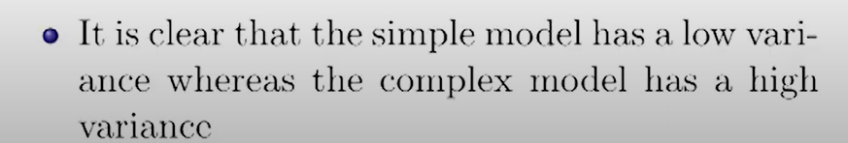
Variance
Tells how much the different prediction models (trained on different samples of the given data) differ from each other

Slide 16
Bias
“Bias is error introduced in your model due to over simplification of machine learning algorithm.”
It can lead to underfitting. When you train your model at that time model makes simplified assumptions to make the target function easier to understand.
Low bias machine learning algorithms — Decision Trees, k-NN and SVM
High bias machine learning algorithms — Linear Regression, Logistic Regression

Slide 17
Variance
“Variance is error introduced in your model due to complex machine learning algorithm,
Your model learns noise also from the training data set and performs bad on test data set.”
It can lead to overfitting.
Normally, as you increase the complexity of your model, you will see a reduction in error due to lower bias in the model.
However, this only happens till a particular point. As you continue to make your model more complex, you end up overfitting your model and hence your model will start suffering from high variance.

Slide 18
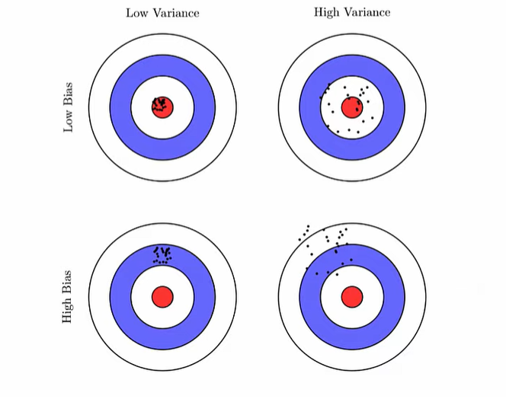


Slide 19


Underfitting and Overfitting

Slide 20
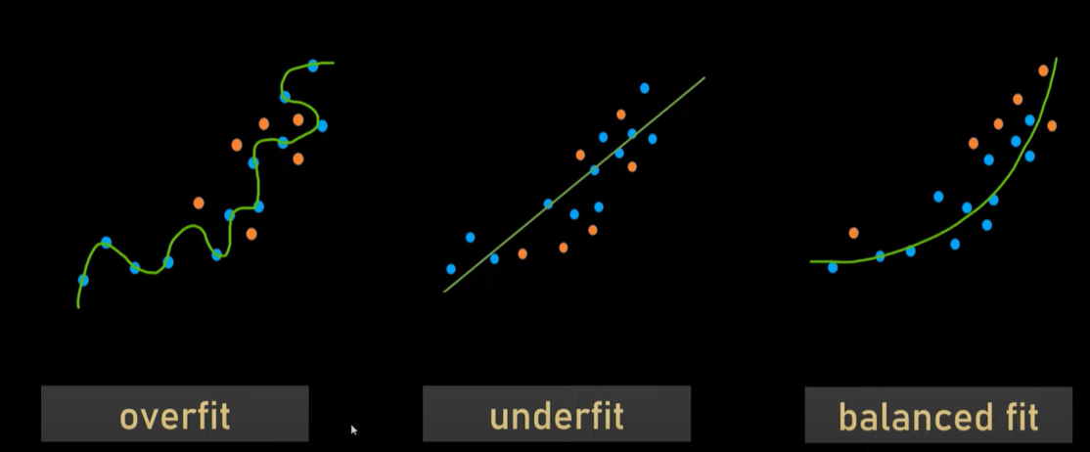

Slide 21
The goal of any supervised machine learning algorithm is to have low bias and low variance to achieve good prediction performance.

Slide 22
Less features--→ underfitting
More features--→overfitting
Only significant features→ get by dimensionality reduction (PCA)

